Slide 1
Community Nursing
Looking after people in their own homes
By Nicki Parry District Nurse

Slide 2
Ask yourself these questions
Why - Do I want to be a nurse?
What - Will it be like?
Who – Should I believe; media; family members; other nurses?
Will – it be what I expected?
I can’t promise to answer these questions, but I hope to start you on the right route; an adaptation of Google maps to community nursing……?

Slide 3
Me as a student nurse; eager to help

Slide 4
Nursing in the community
To be a registered nurse, you need to complete a three year course (We have recently added a new apprentice route, but someone else will tell you about that)
Once qualified you can come straight into the community and you will be a ‘Community Support Nurse’ you will visit patients at home & give a variety of care such as wounds; injections (insulin for people with diabetes); medicines; leg ulcers. Health education; teaching patients to self care.
But in the community our sterile areas are not like in the hospital…….

Slide 5
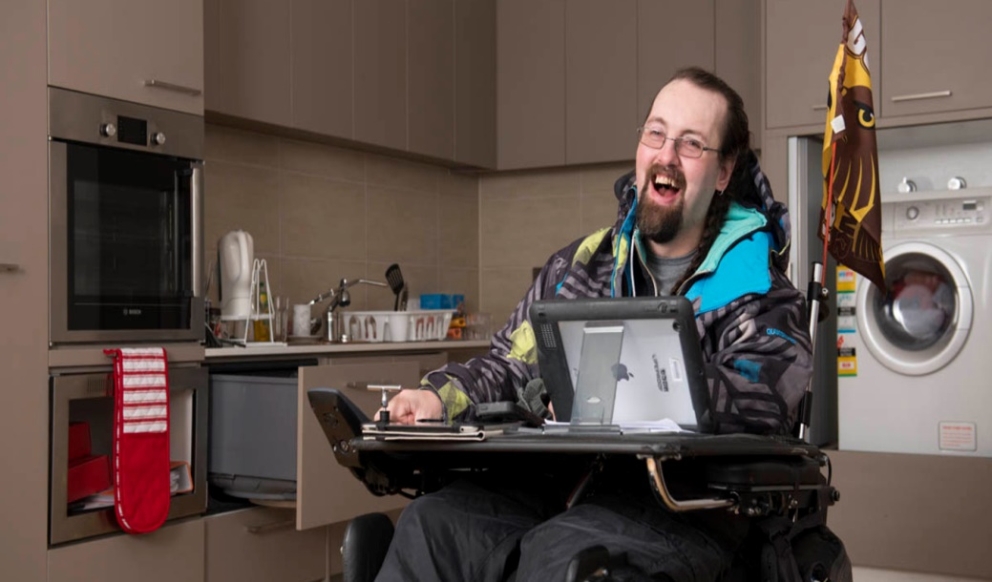
Community nurses see patients in their own home

Slide 6
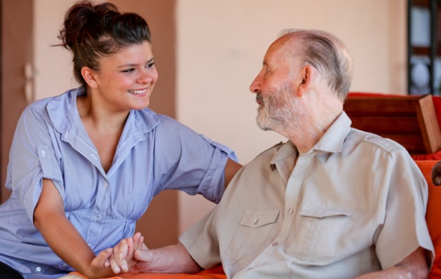
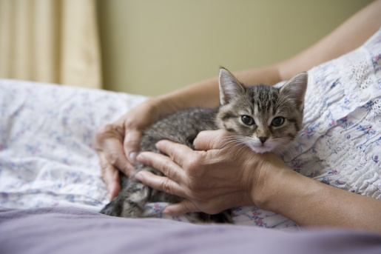
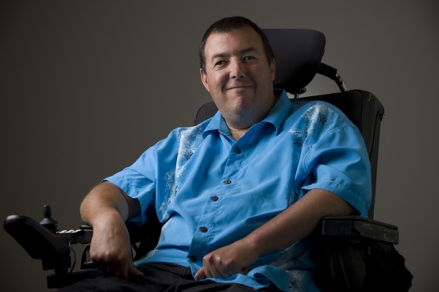
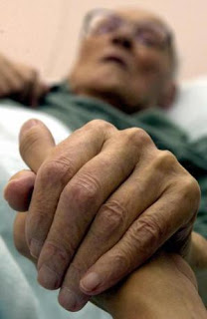
Which patient has diabetes; which one has dementia; which one has heart failure? Of the 2 people sharing a cup of tea, who is the patient?

Slide 7
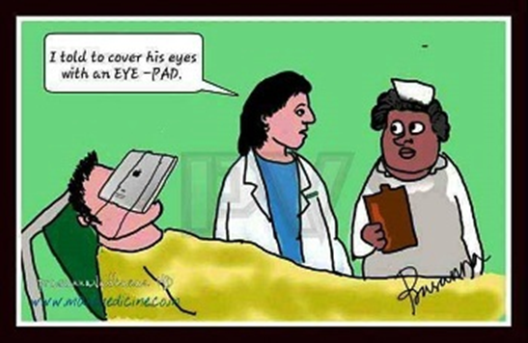
Communication is vital

Slide 8
Pre or during Pandemic?

Slide 9
What is nursing REALLY like?
This is a tough question to answer, a bit like asking what is it REALLY like to be a teenager (although I was one a few years ago..).
If you have a vision of nursing from TV; Social media or being a patient that can be your vision of nursing. I would say it is an incredibly busy job that allows you to be the best you can be, as you see the best and worst days in peoples lives.
Before becoming a nurse if someone was sick, I wanted to be sick with them, lots of people say they can’t stand blood (as long as it isn’t your own you will be fine) In nursing we talk about the six C’s

Slide 10
Hello my name is…..
The six C’s of Nursing:
Communication
Courage
Commitment
Care
Compassion
Competent

Slide 11
Your training should prepare you with these C’s
At the start I asked you to consider why you want to be a nurse; what it would be like and who you should believe, and finally will it be what I expected?
With your back pack of 6 C’s
Communication; Courage;
Commitment; Care;
Compassion & Competence
You are half way there. You don’t need to decide which branch of nursing you should go into straight away (although the community is the best!) and there WILL be people to help and support you along the way; people like me – practice educators. If I can help, here is my E mail: nicki.parry@nhs.net

Slide 12
A poem on nursing
Being a nurse means
You will never be bored.
You will always be frustrated.
You will be surrounded by challenges.
So much to do & so little time.
You will carry immense responsibility, and very little authority.
You will step into people’s lives & you will make a difference.
Some will bless you, some will curse you.
You will see people at their worst.. & at their best.
You will never cease to be amazed at people’s capacity for love, courage and endurance.
You will see life begin…. And end.
You will experience resounding triumphs & devastating failures.
You will cry a lot. You will laugh a lot.
You will know what it is to be human & to be Humane.

Slide 13
Links to look at
www.ucas.com/ucas/after-gcses/find-career-ideas/explore-jobs/job-profile/nurse
(video of student nurses talking about studying)
https://www.hee.nhs.uk/our-work/community-district-nursing
(nine minute video from Queen’s nursing on being a community nurse)
https://www.nmc.org.uk/education/becoming-a-nurse-midwife-nursing
https://clch.nhs.uk/services/district-nursing

